Slide 1
Group 1 Use Case

Slide 2
Agenda
Group 1
Introduction
Use case 1: Rock Retail SE
Case introduction
Solution Task I
Solution Task II
Financial statement analysis
Approach & methodology
Data analysis
Decision template
Automatization potential
Project management
Use case 2: SAP Dashboard

Slide 3





The team - Group 1
Introduction
Moritz Jäger (4922623)
moritz.jaeger@fs-students.de
Nicolas Kepper (8348855)
nicolas.kepper@fs-students.de
Lars Wrede (8464471)
lars.wrede@fs-students.de
Dennis Blaufuss (8458109)
dennis_simon_merlin.blaufuss@fs-students.de
Philipp Voit (8453447)
philipp.voit@fs-students.de

Slide 4

Case 1

Slide 5


The Tools
Case introduction
Excel
PowerPoint

Slide 6

the client – Rock Retail
Case introduction
Headquater near Frankfurt (GER) with currently 80 employees
2 subsidiaries in Paris (FR) and London (GB) as they are important fashion hubs
Unique clothes like you are!
Young start-up
Manufacturer and retailer of private-label apparel in terms of sales including fashion brands like: Frankfurt School, Fancy and Unique.
Multinational retail company (Frankfurt Stock Exchange)

Slide 7



Unique – the pillar brand
Case introduction
End-to-end business model:
Procurement
Design
Retail
Every day clothing (high quality, high functional material)
International designer team on the cutting edge of clothing design
Sold in 5 shops located in different regions of Germany

Slide 8

Customer Relations
Case introduction
The management of Rock Retail tends to strategically optimize their business processes. One of their topics is the “Revenue” stream which includes customer relationship and customers’ account receivables.
Customers are allowed 30 days credit in general (credit sales), with exceptions for a longer or shorter payment term.
Rock Retail offers an early discount of 0.5% settlement within a 10 days payment.

Slide 9
Task I

Slide 10
General reconciliation in Accounting
Task i
Most local GAAP‘s contain doubly entry accounting
Double entry accounting is already a form of reconciliation
Example: Selling a hoodie for 119€ (19% VAT included), payment in 30 days
The structure in SAP is different, but the methodology stays the same:
Note: some actions require special reconciliation
AR to Revenue 100€
AR to VAT 19€
BELNR | BUZEI | HKONT | DMBTR | SHKZG
0100000001 | 001 | 1000000404 | 119.00 | S
0100000001 | 002 | 3000000420 | 100.00 | H
0100000001 | 003 | 4000000069 | 19.00 | H

Slide 11





Reconciliation: revenue (net) with AR
Task i
Direct reconciliation as given in the task in not possible
Revenue and net revenue are two different things (Recall how discounts are booked)
Income Statement is period based while Balance Sheet is date based
AR does not include the cashflows: direct cash payment & AR cash payment
AR includes VAT payments but revenue doesn’t (see example before)
Impaired AR’s may need to be corrected via (specific) allowance for bad loans

Slide 12
Task II

Slide 13
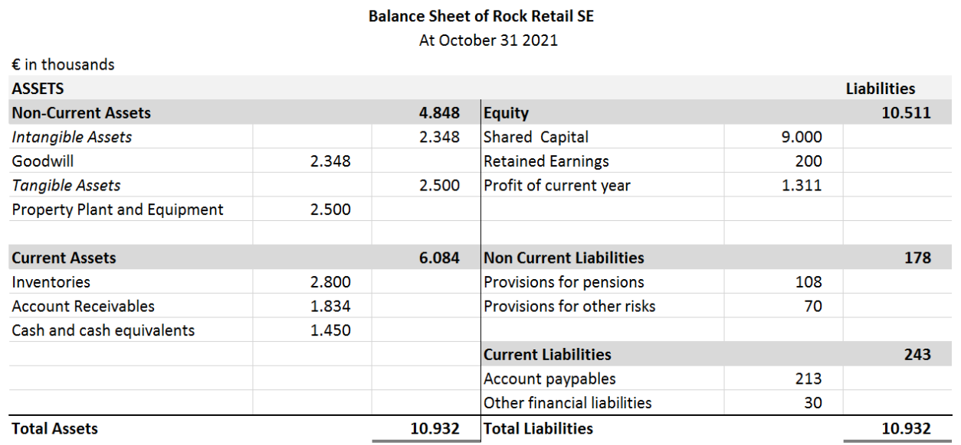
Financial Statement analysis
Task II
Looking at the balance sheet the following observations can be made:
Pro
Strong liquidity due to high CCE
Healthy ratio of AR + Cash vs AP
Very high ratio of Equity to Liabilities
Contra
AR/AP payment terms seem not aligned
Excessive inventory
* Profit = 1.226

Slide 14
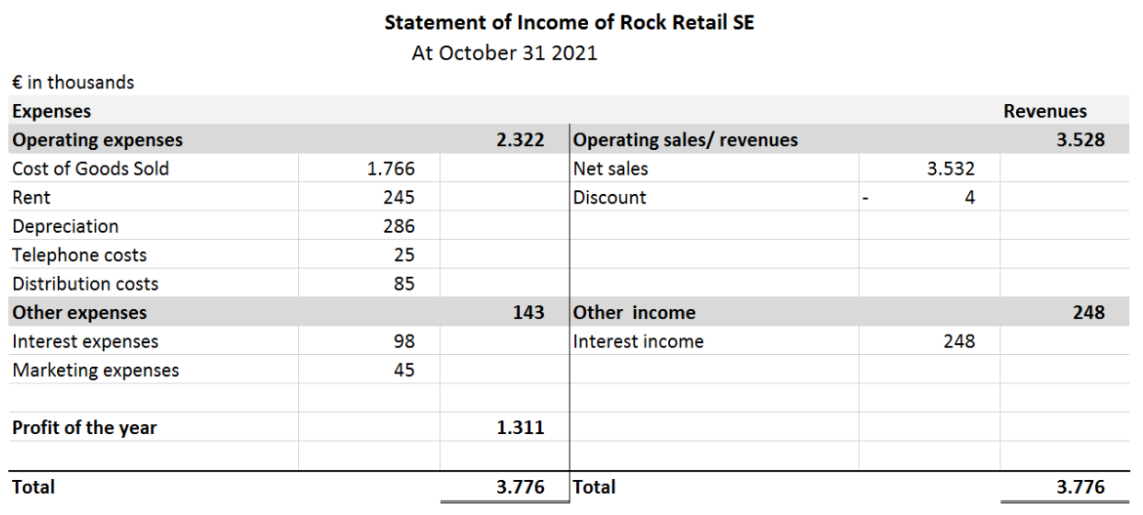
Financial Statement analysis
Task II
Looking at the income statement the following observations can be made:
Pro
Strong margins as profit is above 30% of the total revenue
Very few customers take advantage of the discount
Contra
Error in calculation of operating expenses
High rental expenses
Interest payments seem avoidable
*Operating expenses = 2.407
Profit = 1.226

Slide 15
Approach & Methodology
Task iI
Aging analysis
Open_item_list as basis for the clustering
Assignment of a bucket depending on the due date as different customers have different payment terms
If payment is not received within the time frame of a bucket, the invoice automatically gets moved to the next bucket
Customer | Invoice date | Invoice amount | Open amount | Due date | Days overdue
… | … | … | … | … | …
customer nr. xxxxx
customer nr. xxxxx
≤ 0 days
1-30 days
31-60 days
61-90 days
>90 days
Not overdue
Bucket 1
Bucket 2
Bucket 3
Bucket 4

Slide 16
Approach & Methodology
Task iI
Risk score based on current customer data
Assesment in combination with historical data not possible as we only have received payments and not defaulted ARs Note: historical data as a multiplier of the current risk score would be recommendable
Example:
TODAY
Open amount 4.000 €
(75 days late)
Day of invoice 5.000 €
Payment 1.000€ (20 days late)
Bucket 1
Bucket 2
Bucket 3
Bucket 4
Due date
30 days
60 days
90 days
Risk score:
0 x 0 + 0.2 x 1 + 0 x 2 + 0.8 x 3 + 0 x 4 = 2.6
0 being no risk at all and 4 with a high certainty of default
The risk score is a dynamic value (if days pass and the bucket changes, the risk score increases as well)
0.00
No risk
4.00
High risk

Slide 17
Approach & Methodology
Task iI
Punctuality score on historic customer data
Depending on the punctuality of historic payments of the customers we create a score
This score can be used for decisions regarding payment terms
Example:
Day of invoice 5.000 €
Payment 1.000€ (10 days early)
Payment 4.000€ (75 days late)
Due date
30 days
60 days
Punctuality score:
0.2 x 1 + 0 x 2 + 0 x 3 + 0.8 x 4 = 3.4
1 being customers that pay punctual, 4 customers that pay way to late
A customer with a score over 2.00 should potentially not get credit sales
Only pre-payment
1.00
Punctual
2.00
Acceptable
3.00
Late
4.00
Very late

Slide 18
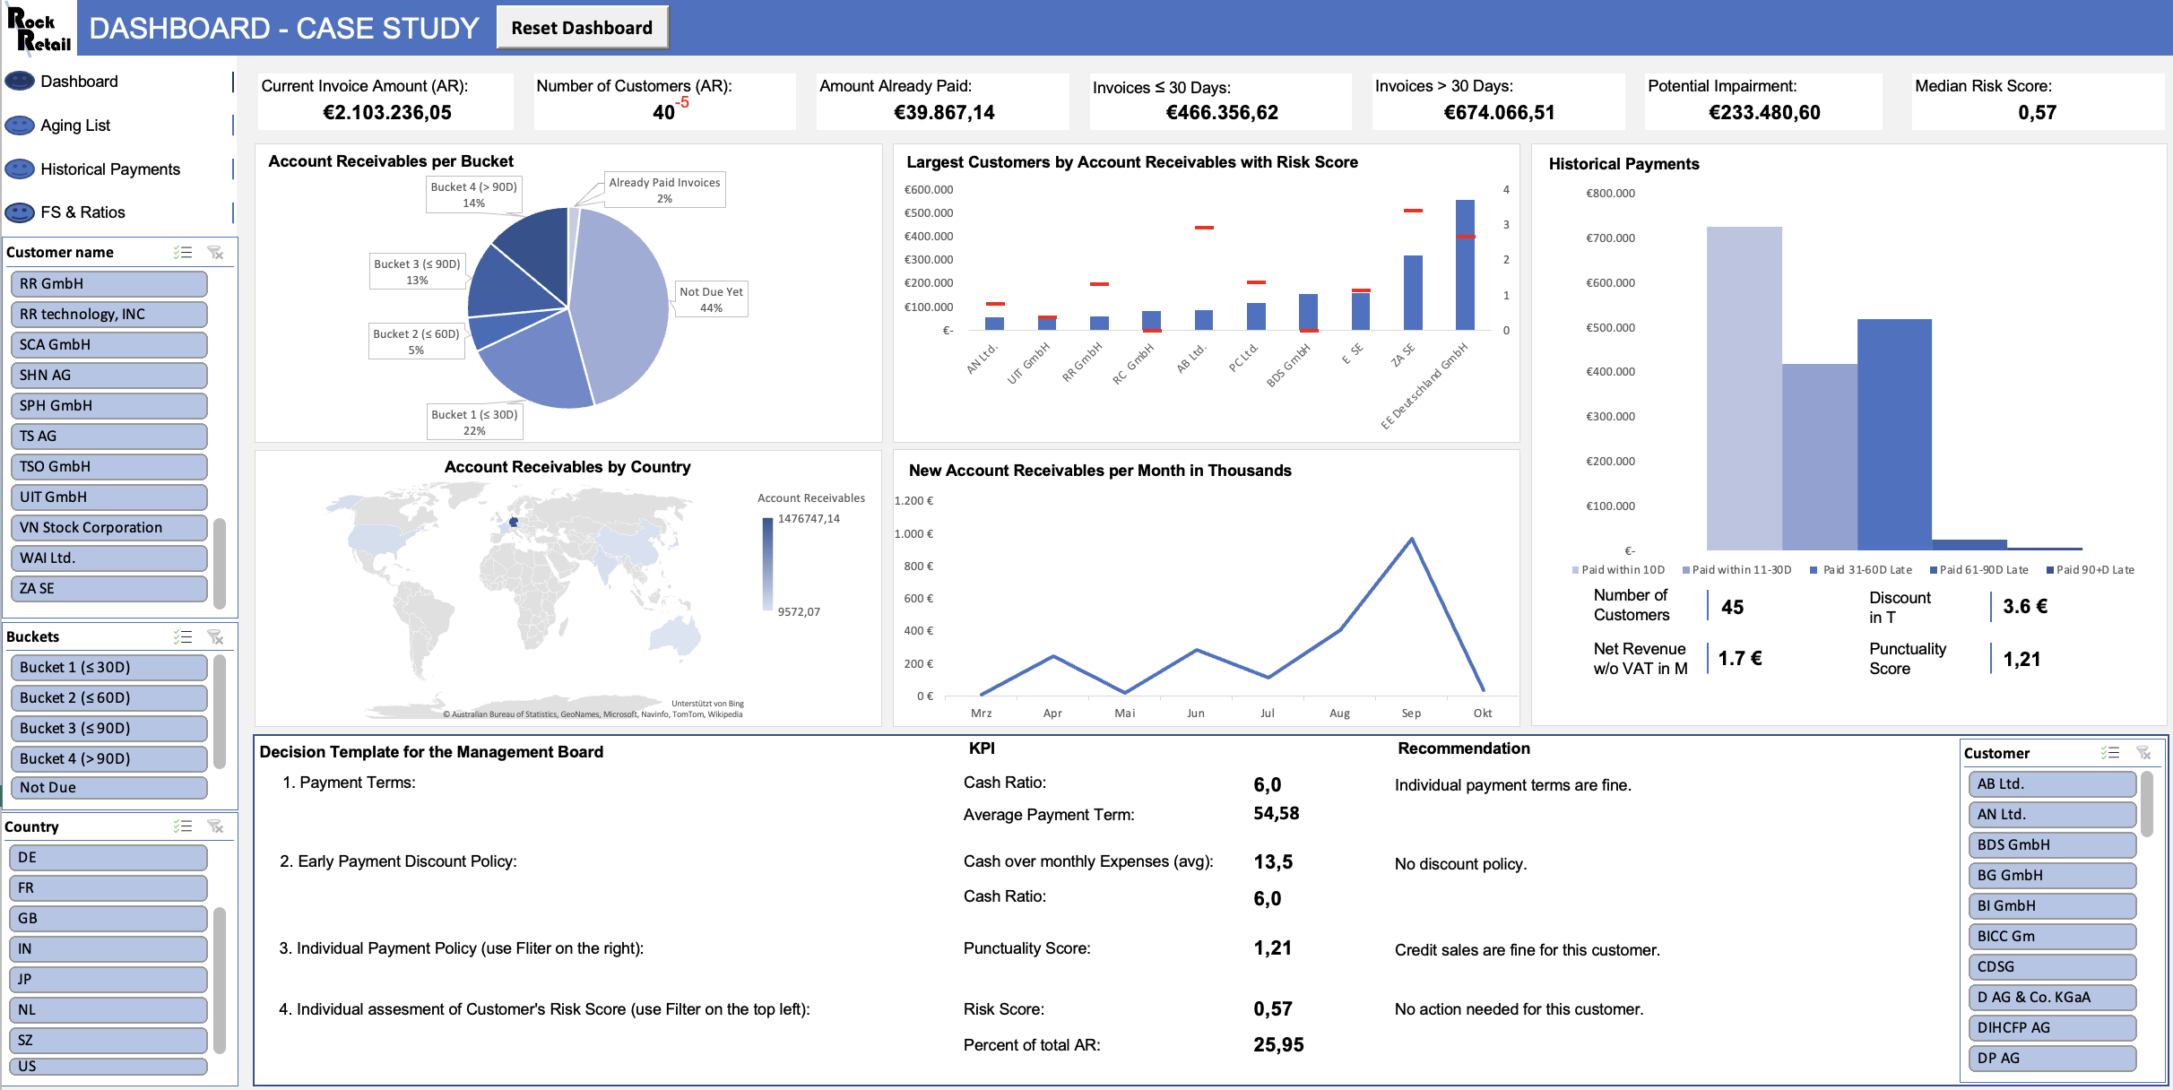
Data analysis
Task iI
Showcase of the Excel dashboard
Key figures
Filter
Tables
Decision template

Slide 19
Data analysis
Task iI
Accounts receivable per bucket
Already paid
Bucket 4 (> 90d)
Use:
Gives a quick overview how the receivables are distributed
The darker the colour the higher the default risk and hence impairment rate
Analysis:
Almost half of the ARs are in the no risk area
Nearly 30% is in an dangerous area of default
Size of last bucket is too big (High risk!)
Bucket 3 (≤ 90d)
Not overdue
Bucket 2 (≤ 60d)
Bucket 1 (≤ 30d)

Slide 20
Data analysis
Task iI
Largest customers by account receivables witch risk score
Use:
Shows which clients have the highest outstanding amounts in combination with their risk score
Management can make targeted follow-ups
Analysis:
One client “EE Deutschland GmbH” is responsible for nearly 30% of the account receivables with a risk score close to 2

Slide 21
Data Analysis
Task iI
Deep Dive into EE Deutschland GmbH - Account receivables per Bucket
Already paid
Use:
If one finds high dependencies or irregularities, the management can have a deeper look into the customers data
Analysis:
This client has 40% of the receivables in Bucket 4 which means it is at high risk of default
Current risk score is 1.96
Not overdue
Bucket 4 (> 90d)
Bucket 1 (≤ 10d)

Slide 22
Data analysis
Task iI
Account receivables by country
Use:
Gives a quick overview from which countries the different customers are
Different countries have different tax and accounting laws
Analysis:
Mostly German customers
Rest of the countries have minor amounts of accounts receivables
Main focus should therefore be on the German market

Slide 23
Data analysis
Task iI
Historical payments by clusters
Use:
Gives an overview within which time frame customers paid for their goods
Visualizes effectiveness of discounts
Analysis:
More then 70% paid within 30 days
40% took advantage of the 0.5% discount
The lost profit due to the discount is negligible (0.2% of total revenue)

Slide 24
Data analysis
Task iI
New account receivables per month (in thousands)
Use:
Evolution of the account receivables over the periods
Analysis:
Steep incline over the months Aug & Sep
3 months with nearly 0 gods sold (March, May, October)
Further investigation regarding fluctuation necessary

Slide 25
Decision template
TASK ii
Management decision matrix
1. Payment terms
2. Payment discount
3. Credit sales
4. High risk customers
Condition
Cash ratio below threshold 2
Cash over monthly expenses below 3 AND
cash ratio below 2
Punctuality score above threshold 2
Risk score above 2 and share of total AR’s above 5%
Recommendation
Fix payment terms to 30 days
Activate discount policy
Prohibit credit sales for unpunctual customer
Contact and further inspection of customer (e. g. debt restructuring)
Advantages
Increases mid term liquidity
Increases short term liquidity
Reduces default risk
Increases recoverability of outstanding amount
Disadvatages
Potentially damages customer relationship
Decreases profit
Potentially lost sales
Requires higher effort

Slide 26



Decision Template
Task ii
General recommendations
1. Implement controls
For reporting purposes and to prevent errors (reconciliation)
To increase usability in the accounting system
2. Keep an eye on bad debt and overdue receivables
Update buckets > 30 days for lump-sum allowances based on historical payment data
Monitor changes and potential impact from impairments
Implement distress indicators for individually significant customers early in the process
3. Gather more data to include more meaningful KPIs
Add potential impacts from expected credit loss
Consider modelling impact from material events and country specific risks
Inspect alternative option to fulfil cash ratios such as factoring, credit lines, etc.

Slide 27



Automatization Potential
Task ii
Outlook: Optimizing the analysis on a regualar basis
1. Status quo
Dashboard is fully automated (with mentioned Excel restrictions)
Input data sheets allow new inputs -> will be automatically added to pivot calculations
2. Biggest problems
Data transfer from client ERP to Excel
Data interface & structure in client ERP is unknown
Excel input sheets have a very strict ruleset of formatting/structuring for given data
3. Solutions & Thoughts
Excel Makro to transform ERP extraction data structure to desired one
Optimally use a web-based application to not save and modify data locally

Slide 28



Project management
Project Management
Focus on an agile workflow to maximise results
1. Reading and reviewing of the cases
Understanding of the given data sources & structure
Identification of To-Do’s
2. Identifying strengths of the different group members
Distribution of the tasks depening on the strengths of individual team members (more tech related, others with an accounting background, etc.)
Individual working sprints for the assigned tasks
3. Continuous reviewing
Due to the tight deadline, problems were discussed and solved immediately
Consultation of different views on problems (tech, accounting, etc.)
Major rework of critical parts as full group

Slide 29
Case 2: SAP Dashboard

Slide 30
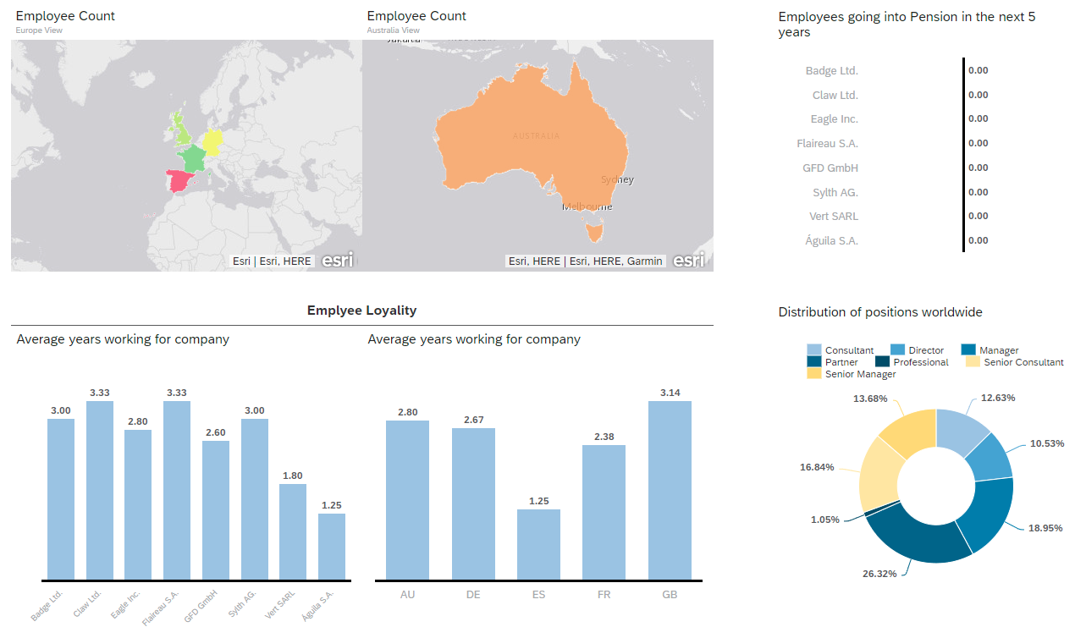
Screenshots Dashboard
Case 2

Slide 31
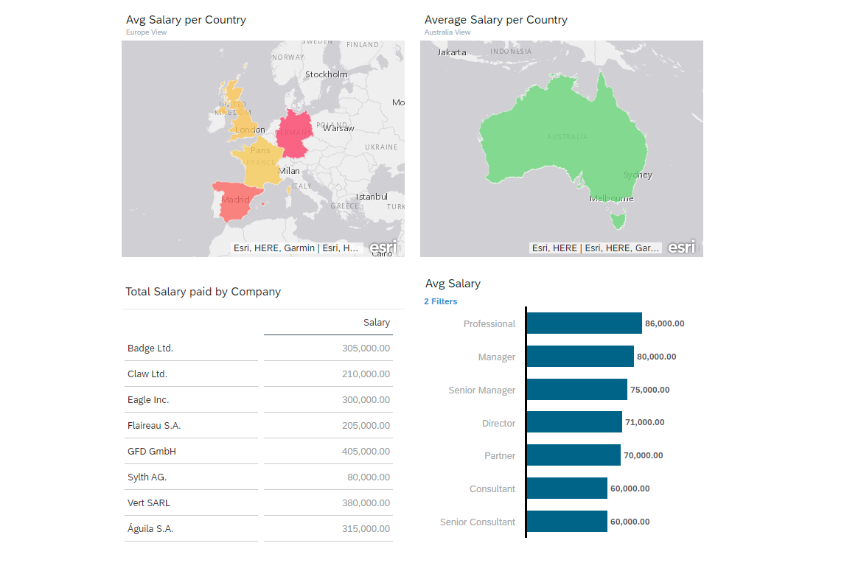
Screenshots Dashboard
Case 2

Slide 32
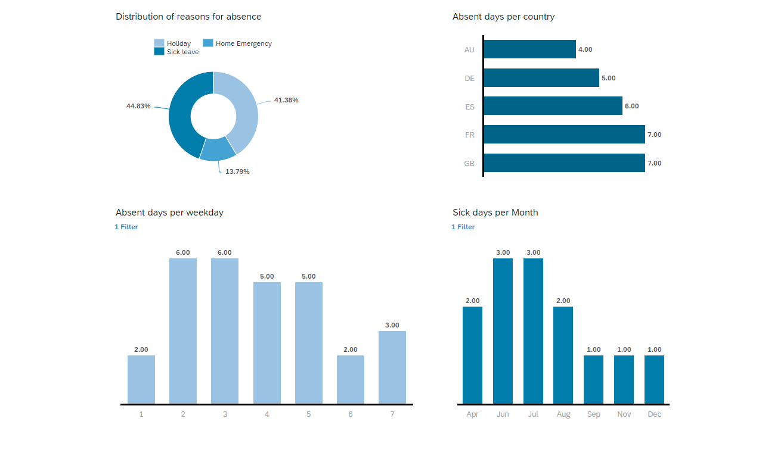
Screenshots Dashboard
Case 2

